Slide 1
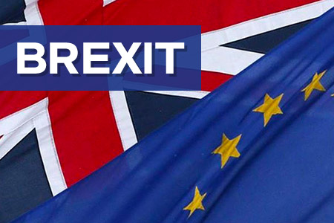

Slide 2
WHAT WAS THE INITIAL EFFECT AND WHAT DOES THE FUTURE LOOKS LIKE

Slide 3
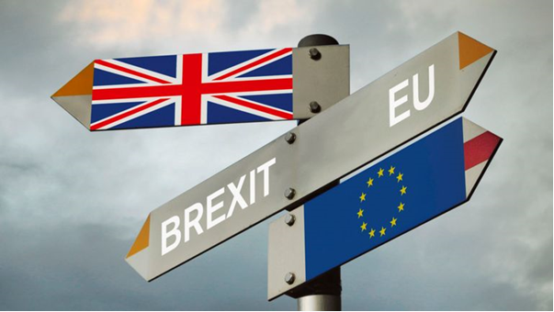
What does Brexit mean?
The word "Brexit" is a new word in English:
the first letters Br means "Britain" and the exit means "exiting".

Slide 4
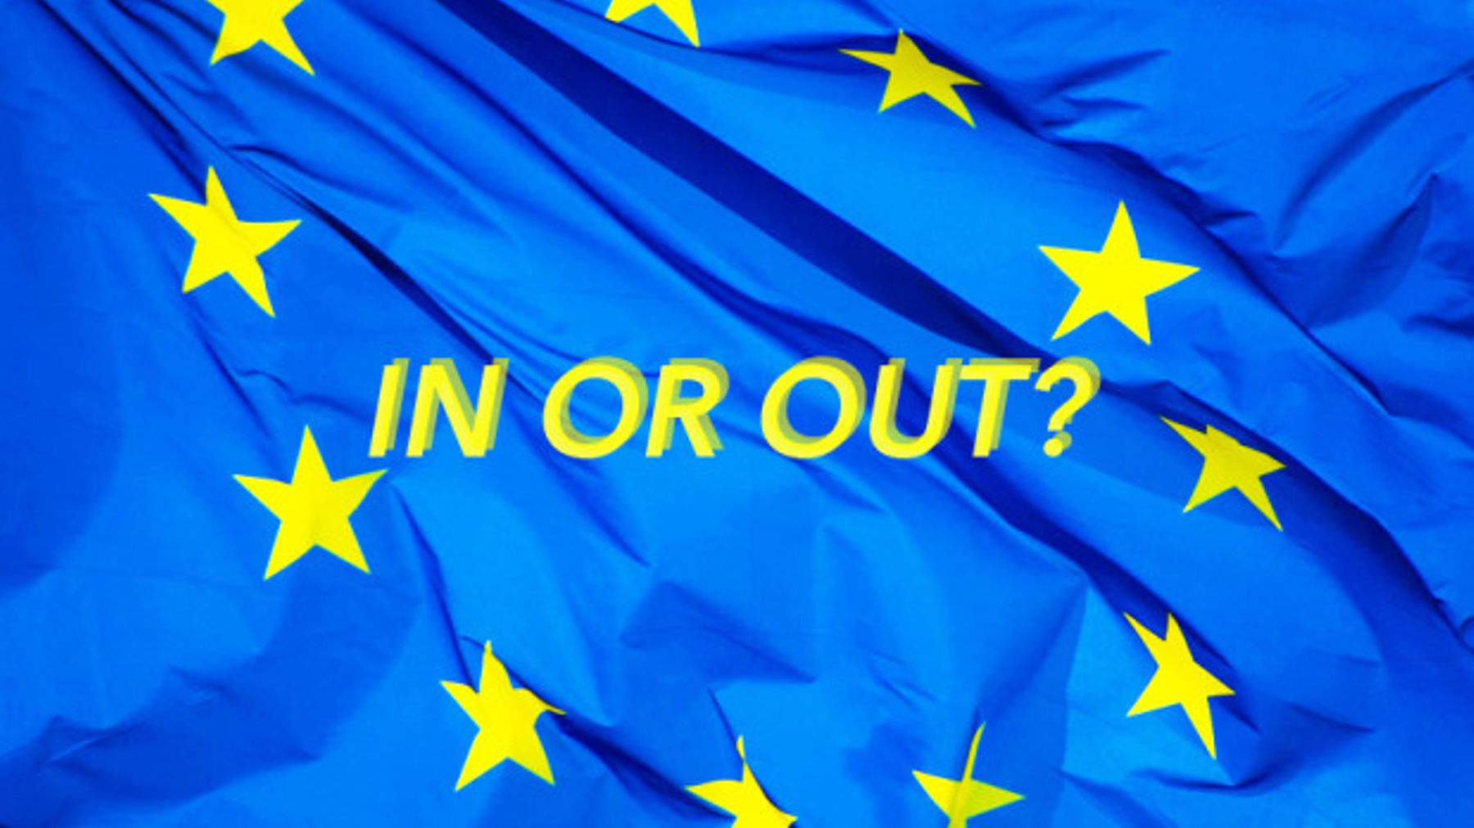
A referendum
A public vote - called a referendum - was held on 23 June 2016 when voters were asked just one question - whether the UK should leave or remain in the European Union.

Slide 5
Results
The Leave side won
by nearly 52% to 48%
(17.4m votes to 16.1m)
But the exit didn't happen straight away.

Slide 6
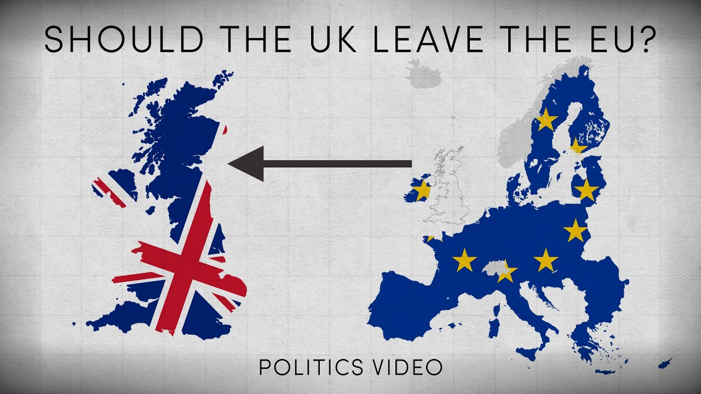
Why is the UK leaving?
The reasons 17.4m people voted to leave the EU were multiple and complex.
But it is beyond doubt that a desire to control immigration was the most important reason and in addition, sovereignty, the principle that decisions about the UK should be taken in the UK.

Slide 7
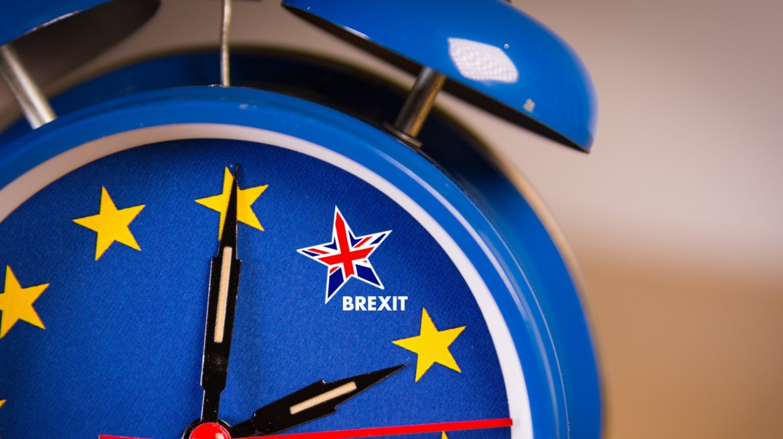
Why hasn't Brexit happened yet?
Brexit was due to happen on 29 March 2019. But the Brexit date has been delayed twice.
The UK and the EU agreed a deal in November 2018 but MPs (members of parliament) rejected it three times.

Slide 8
What has happened so far?
The 2016 vote was just the start. Since then, negotiations have been taking place between the UK and the other EU countries.
The discussions have been mainly over the "divorce" deal, which sets out exactly how the UK leaves - not what will happen afterwards.
This deal is known as the Withdrawal Agreement.

Slide 9
What does the withdrawal agreement say?
The withdrawal agreement covers some of these key points:
the rights of EU citizens in the UK and British citizens in the EU
how much money the UK was to pay the EU (widely thought to be £39bn)
the backstop for the Irish border.
a transition period, which has been agreed to allow the UK and EU to agree a trade deal and to give businesses the time to adjust.

Slide 10
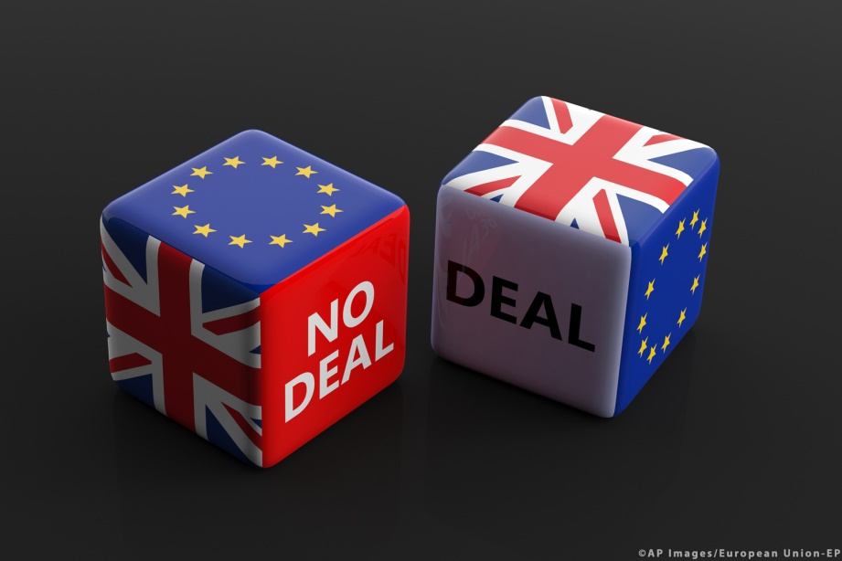
That means that if the withdrawal agreement gets the green light, there will be no huge changes between the date of Brexit and 31 December 2020.
The deal was agreed by the UK and the EU in November 2018, but it also has to be approved
by British MPs.

Slide 11
Have MPs backed the withdrawal agreement?
No. They have voted against it three times.
On 15 January they rejected the deal by 432 votes to 202 - a record defeat.
Then on 12 March, after Theresa May - the prime minister at the time - had gone back to the EU to secure further legal assurances, they rejected it again.
And on 29 March - the original day that the UK was due to leave the EU - MPs rejected it for a third time (this vote was slightly different as it did not include the political declaration).

Slide 12
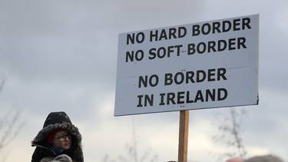
What is the backstop?
The backstop is meant to be a last resort to keep an open border on the island of Ireland - whatever happens in the Brexit negotiations.
It would mean that Northern Ireland, but not the rest of the UK, would still follow some EU rules on things such as food products.

Slide 13
What happens now?
Boris Johnson has said he wants to renegotiate the withdrawal agreement with the EU - and remove the backstop.
If he succeeds in doing this, it will still have to be approved by MPs before being passed into UK law.
However, EU leaders have consistently said they will not renegotiate the withdrawal agreement and that the backstop is an essential part of any deal.

Slide 14
What happens if there is no new deal?
If the prime minister fails to convince the EU to change the withdrawal agreement, he has promised to take the UK out of the EU without a deal on 31 October.
Leaving the EU without a withdrawal agreement would be known as a "no-deal Brexit"

Slide 15
What happens if the UK leaves without a deal?
"No deal" means the UK will have failed to agree a withdrawal agreement.
1. There would be no transition period after the UK leaves and EU laws would stop applying to the UK immediately.
2. The contents of shopping basket may change. It expects some food prices could rise.
3. Travelling to Europe will take extra measures (visa, border control).

Slide 16
Thank you!

